Slide 1
Assignment 0 The DTU 10MW and HAWC2S

Slide 2
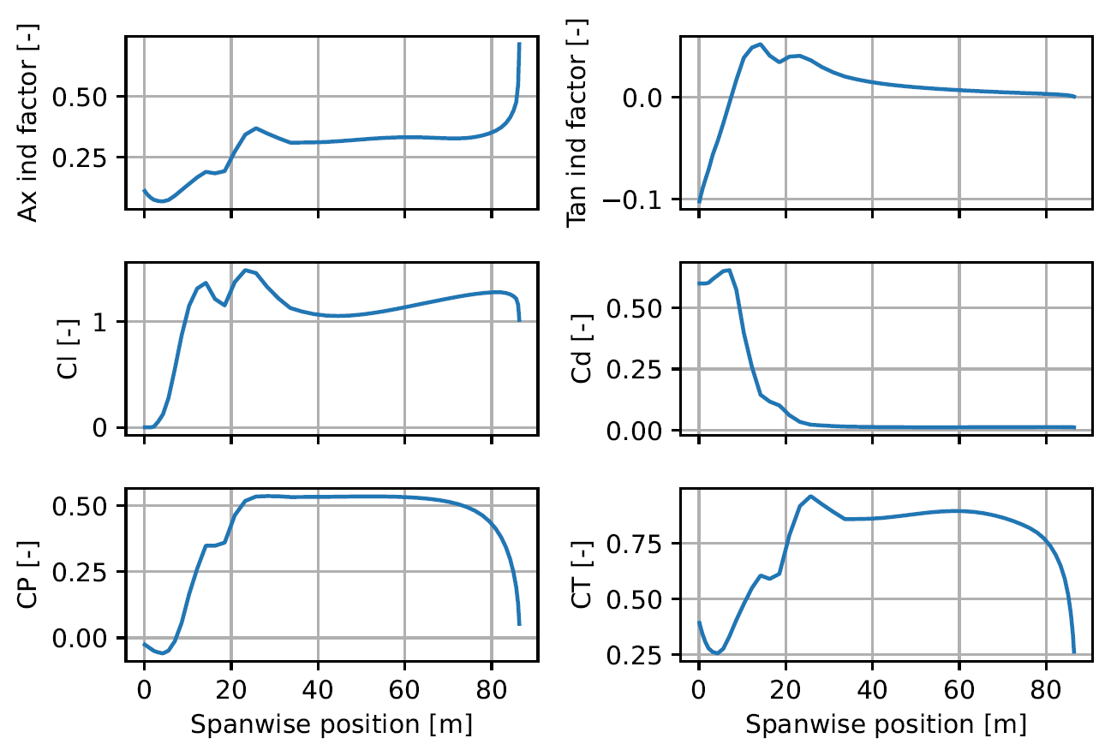
Part 1: Spanwise values
Notes:
Nils

Slide 3
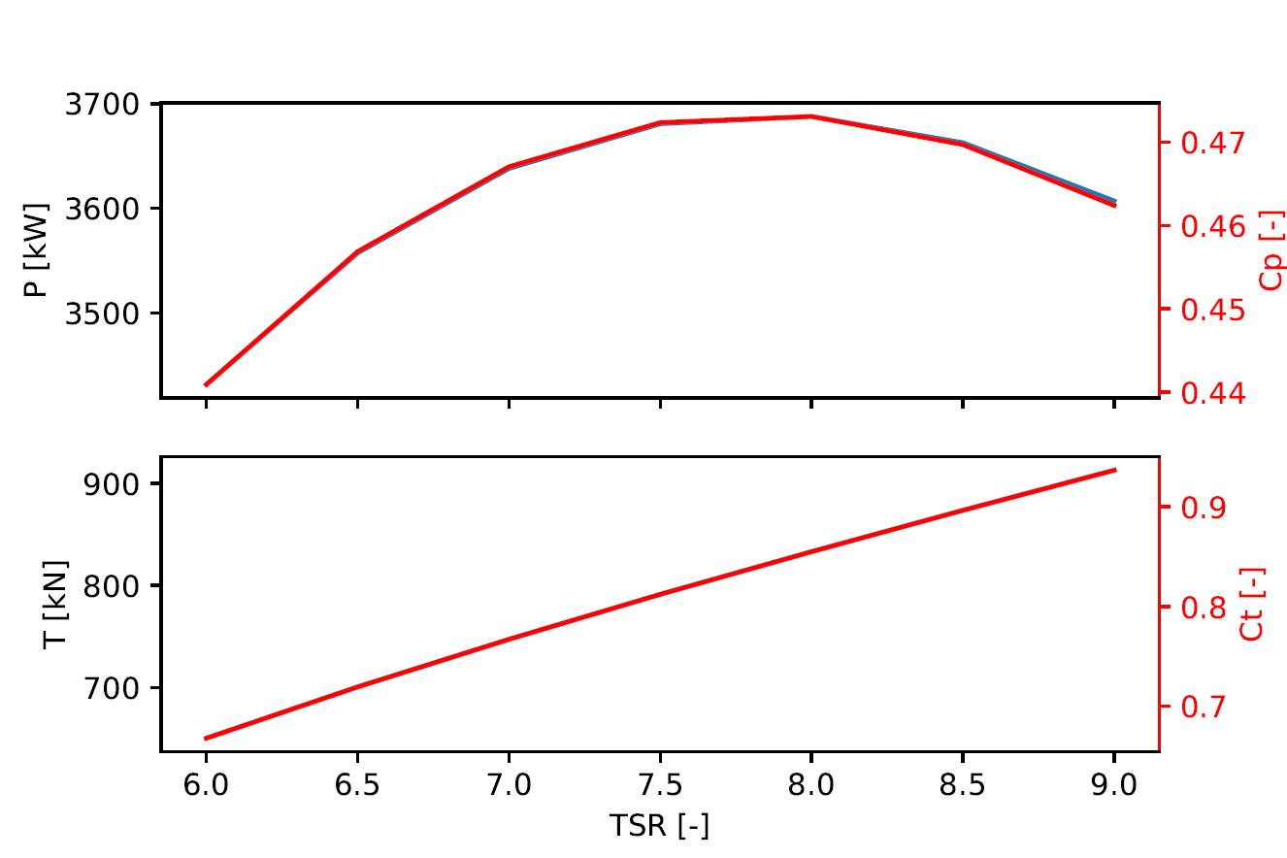
Part 2: Multiple TSR values
Notes:
Eduardo

Slide 4
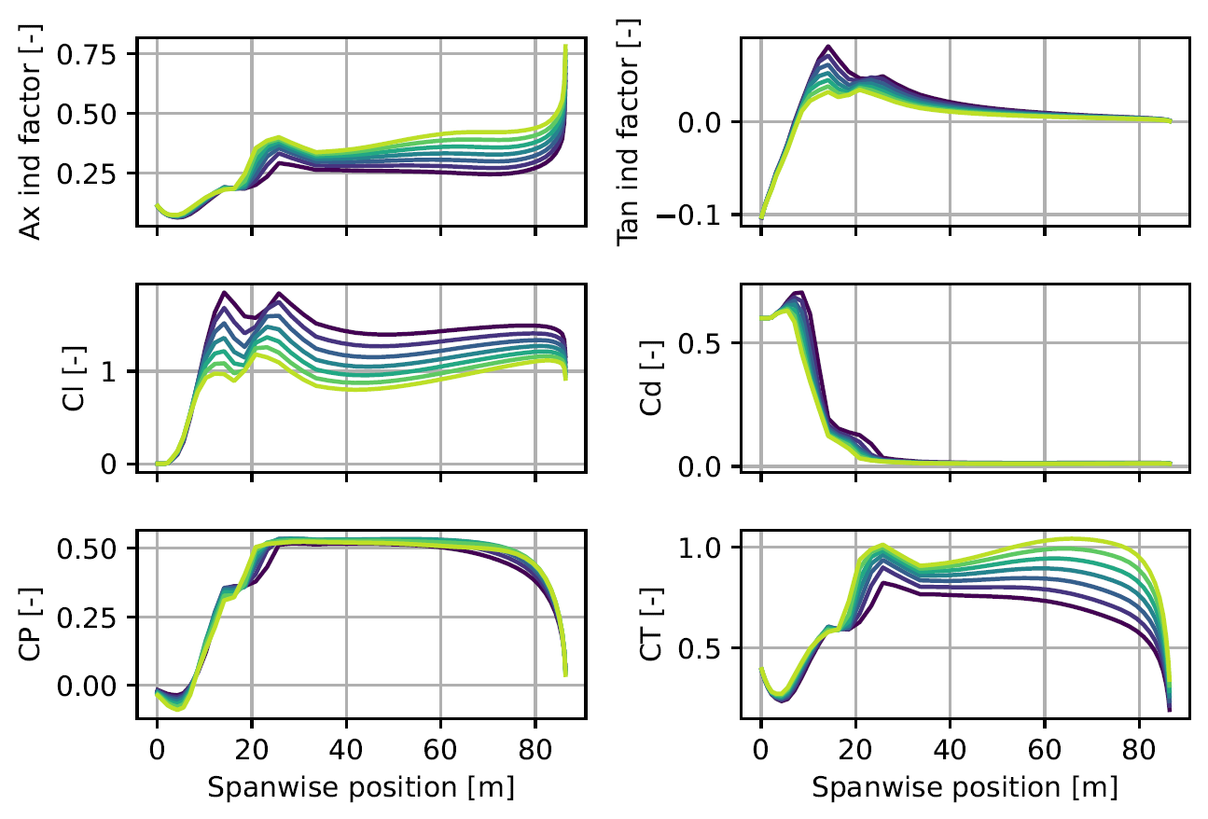
Part 2: Multiple TSR values
Notes:
Nick

Slide 5
Part 3: Chord, twist, and thickness
Chord, twist, and thickness plot
Notes:
Stef

Slide 6
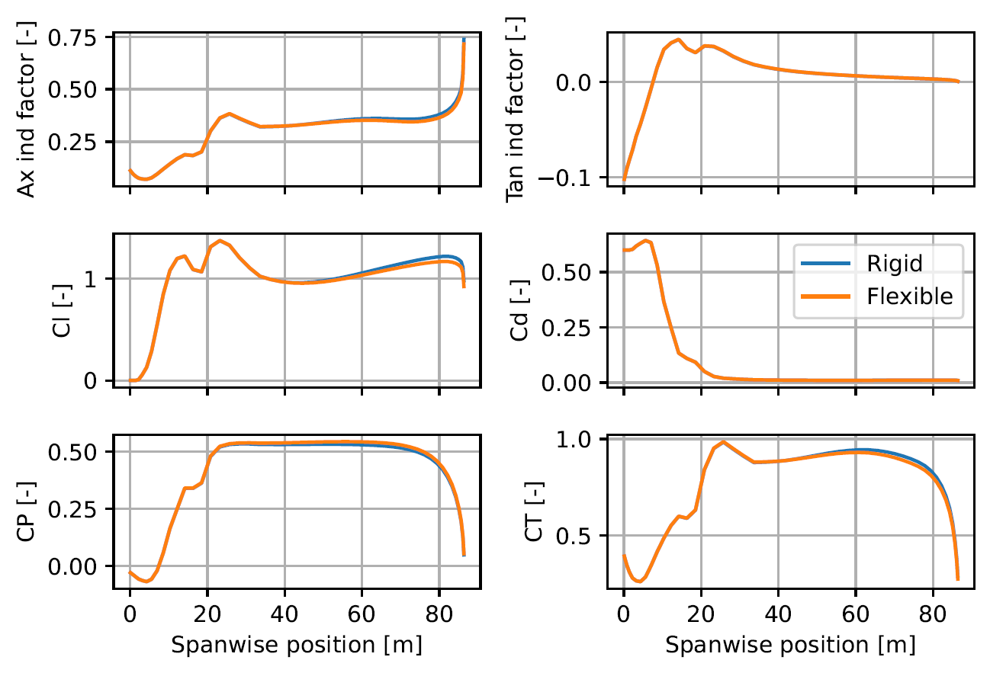
Bonus level: Investigate flexibility
Notes:
Nils

Slide 7
Bonus level: Investigate flexibility
Power and thrust curves
Notes:
Nils

Slide 8
Appendix

Slide 9
Insert other figures/tables here

Slide 10
Group 8 work distribution.
All group members ran calculations separately and cross-checked results, discussing any discrepancies.
Presentation was split up as follows:
Figure 1: Nils
Figure 2: Eduardo
Figure 3: Nick
Figure 4: Stef
All group members discussed scripts before presenting.

